Slide 1
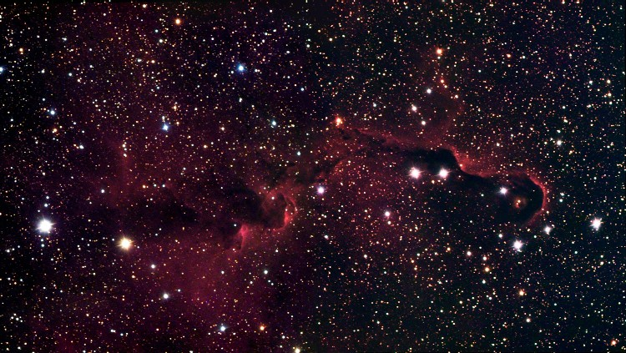

N-body simulations of young protostellar systems
By Gerwyn Jones

Slide 2
Content
Brief overview of the formation of young protostellar systems
Objectives of the project
Method and results of the project
Analysis and future plans for the project

Slide 3
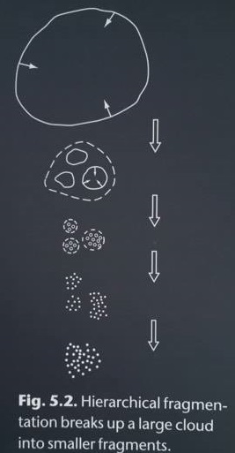
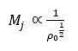
Previous predictions of star formation
Hierarchical fragmentation is where molecular clouds start to collapse, the density increases as the cloud collapses and the Jeans mass decreases until the mass of the cloud is greater than Jeans mass.
Jeans Mass
If M_{cloud} > M_{J} Cloud Fragments
(Ward-Thompson & Whitworth, 2011)

Slide 4
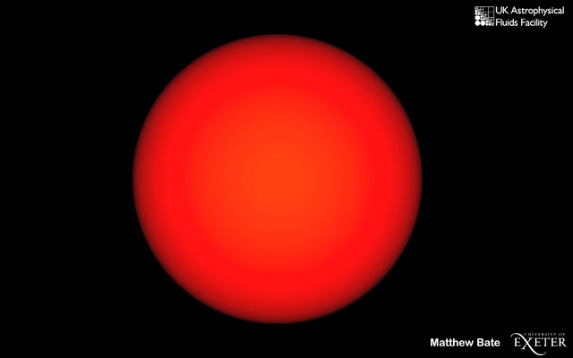
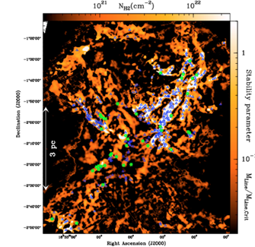
Current theory of star formation
Filamentary structures have made a resurgent theory of interest due to the Herschel Gould Belt Survey.
Filamentary structures generally have the highest column densities observed in molecular clouds.
Protostars are thought to be found within these filamentary structures.
(André, et al., 2010)

Slide 5
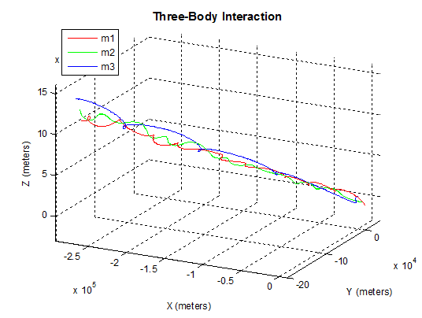
Objective of the project
Finding parameters of binary systems such as eccentricity and semi-major axes and probability of ejectas in different initial conditions.
(Dahir, 2013)

Slide 6
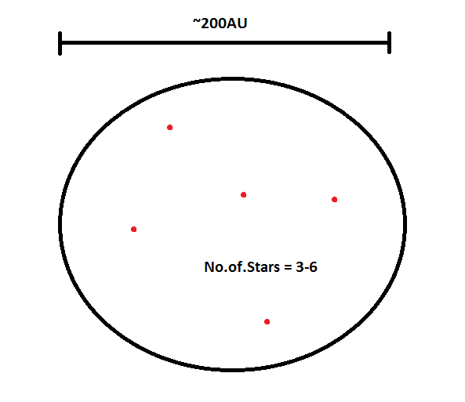
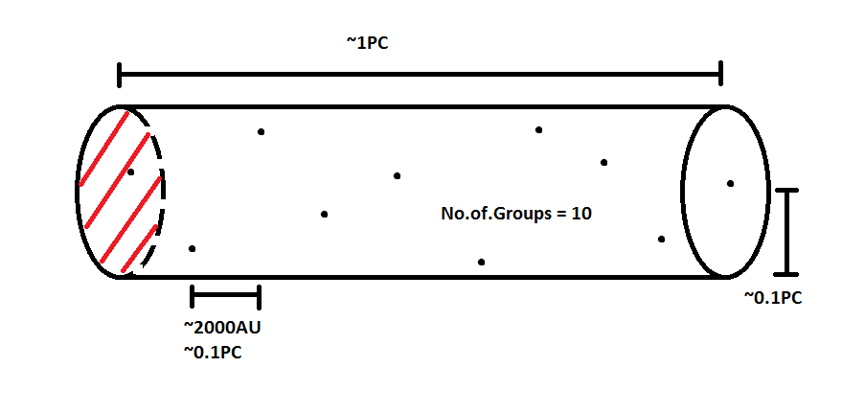
Setting up the conditions for the N-body simulation
Placing 10 groups of stars in random positions in a cylinder of length ~1Pc and radius ~0.1Pc
Each group in virial equilibrium
I.e 2T + Ω = 0

Slide 7
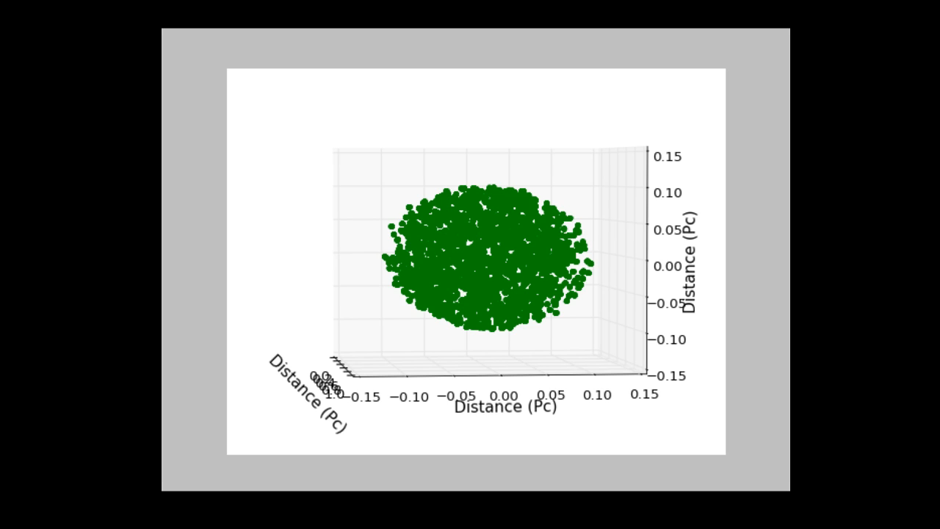
Proving the initial conditions for the N-body simulation
Placing 1x10⁴ groups in each group to show the extreme case.

Slide 8
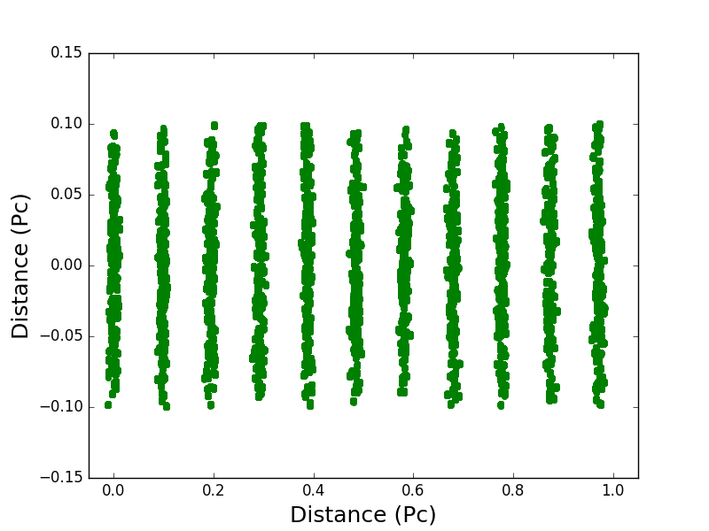
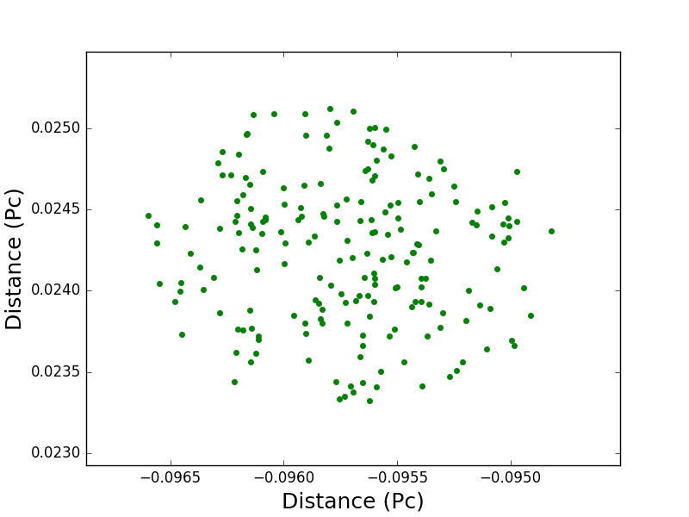
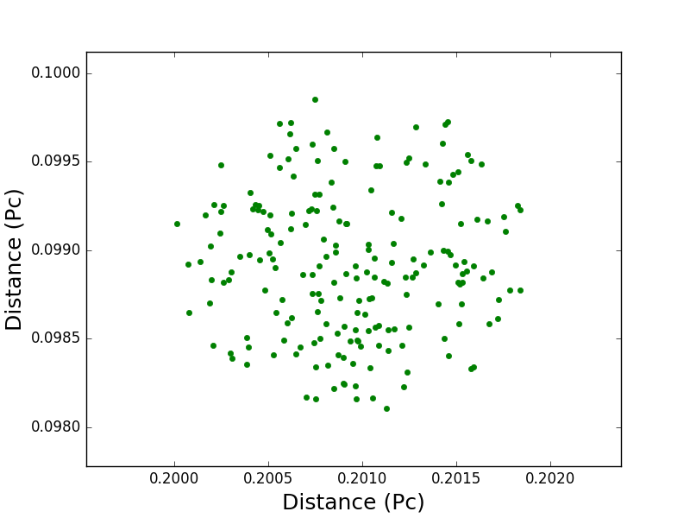
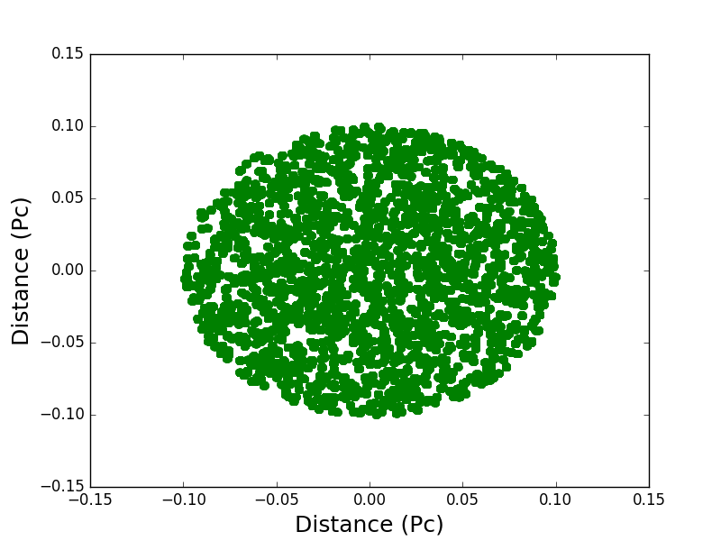
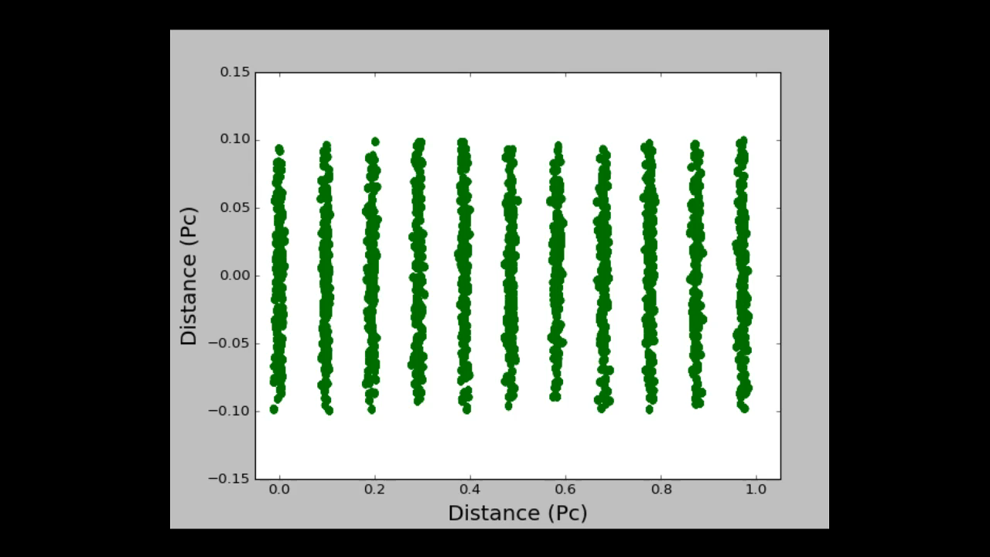
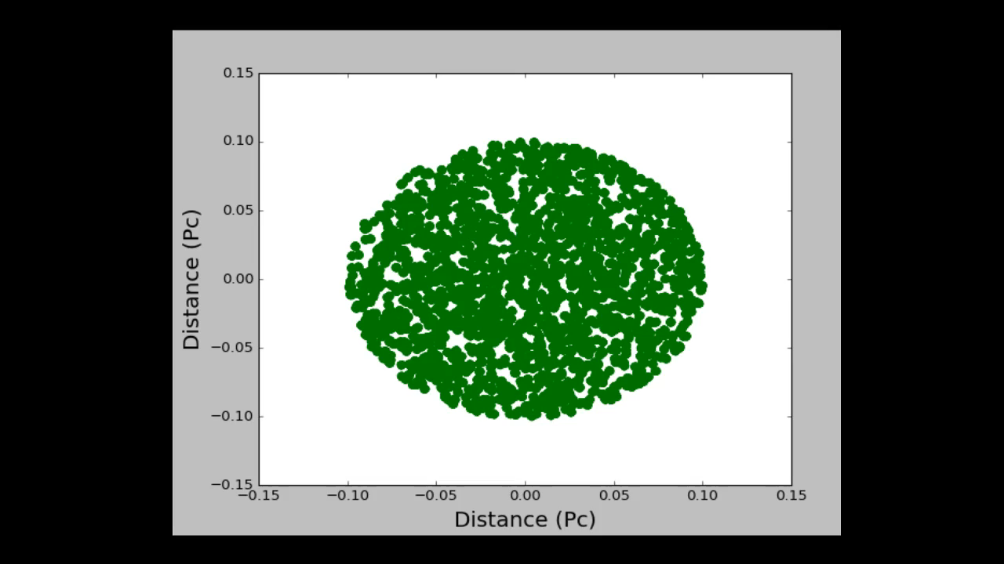
200 stars are placed randomly in within these groups.

Slide 9
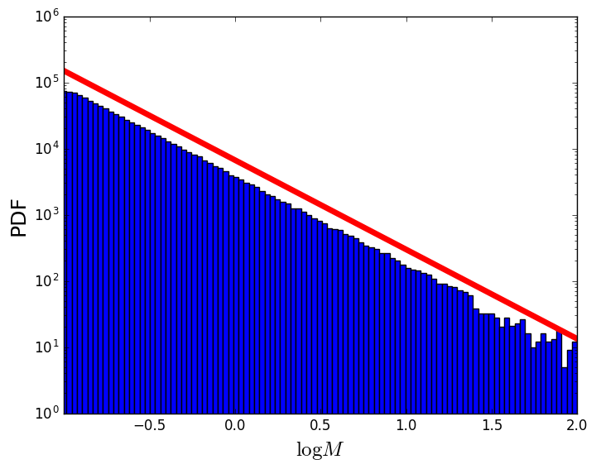
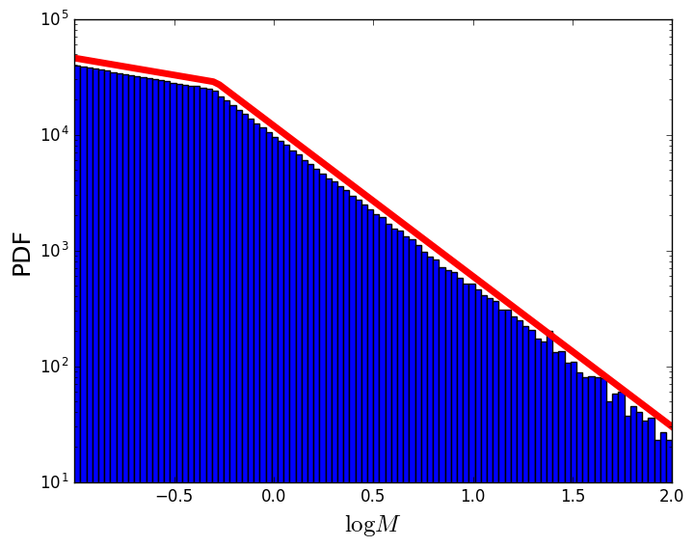
Setting up the masses of the protostars using the IMF
The IMF is often assumed to have a simple power law given by :-
Salpeter IMF
α = 2.35 for Salpeter
α = 1.3 0.1 < M < 0.5
α = 2.3 0.5 < M for Kroupa
Kroupa IMF

Slide 10
Finding the positions of the stars at each point in time.
Numerical equation for newtons law of gravitation :-
Where ϵ is the softening parameter.

Slide 11
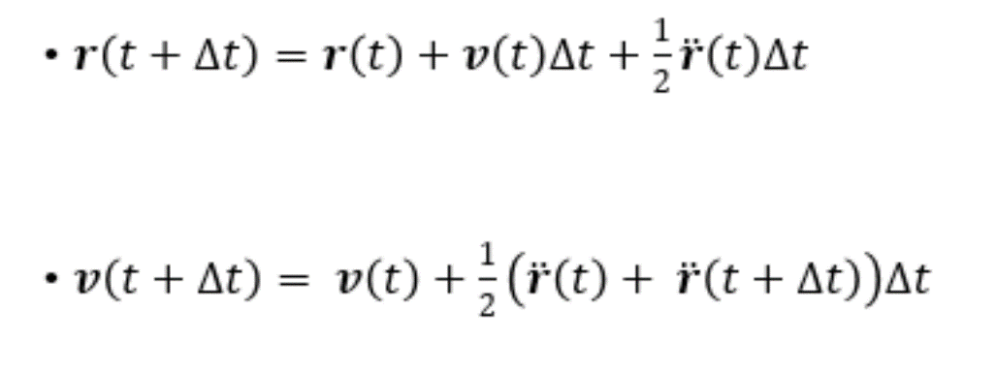
Verlet method of integration
Finding the position through the verlet method :-

Slide 12
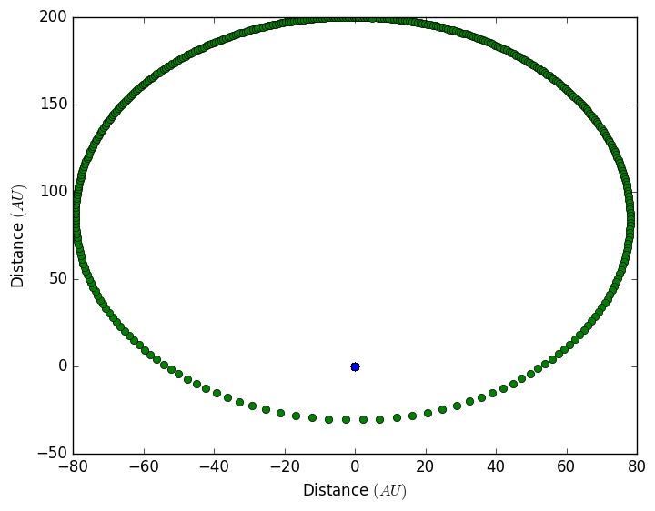
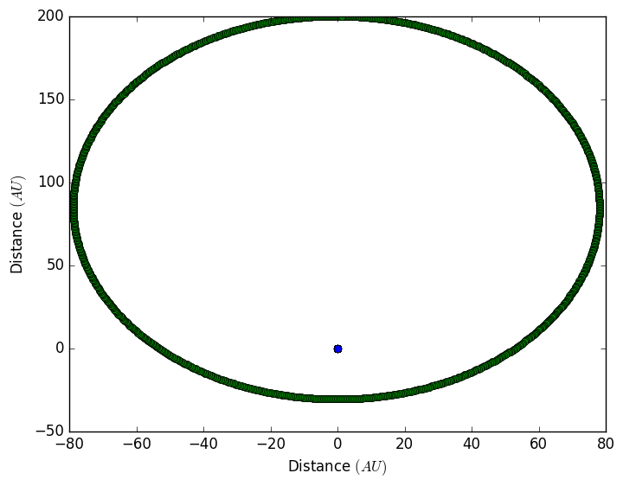
Adaptive time steps
To speed up the integrator the time steps can be made to be adaptive, and is given below as :-
Constant time step
Adaptive time step

Slide 13
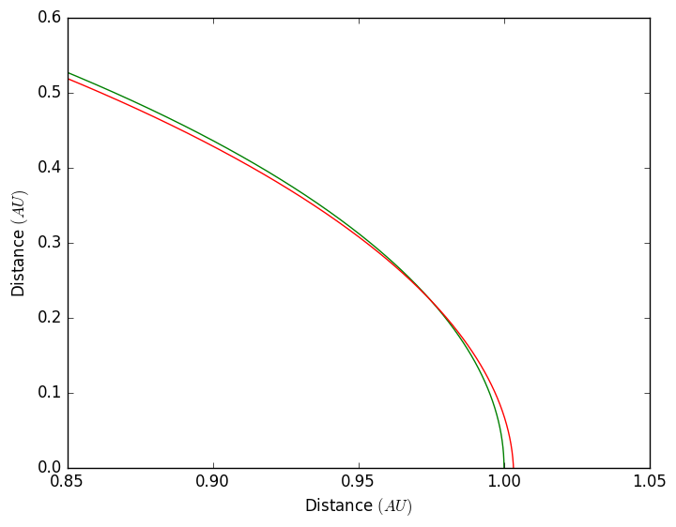
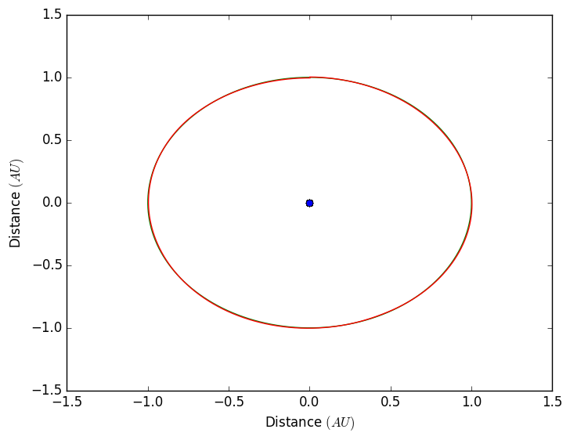
Verifying the simulation code
Using the Sun, Earth and the Moon model to ensure that the code is working.
A graph of the orbital paths of Earth (green) and the moon (red) with the sun at the centre (blue).

Slide 14
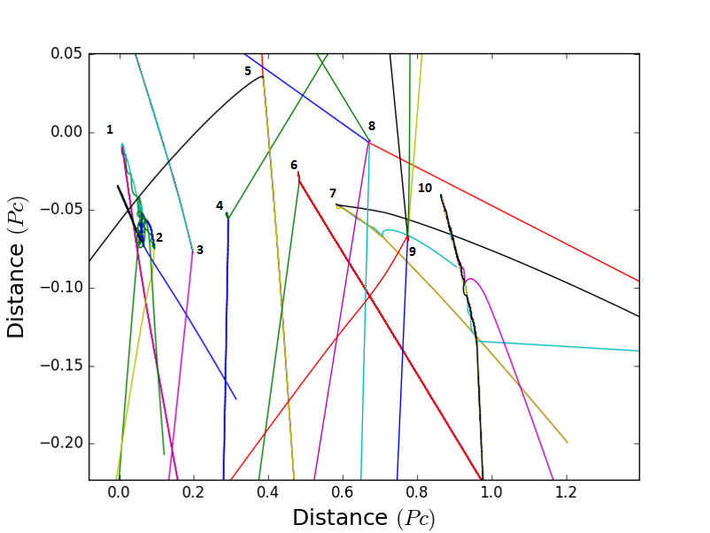
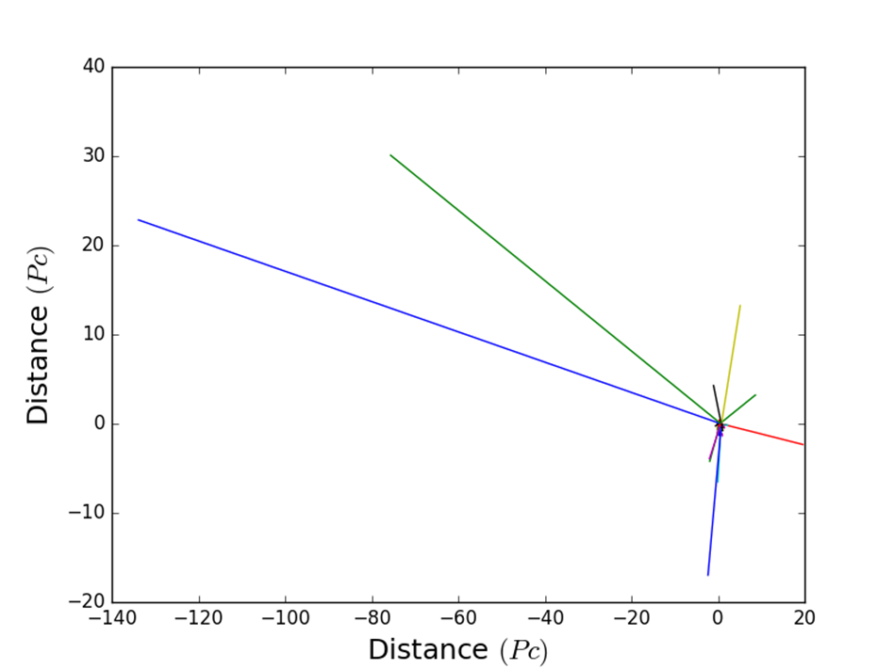
Dynamical interactions of the protostars

Slide 15
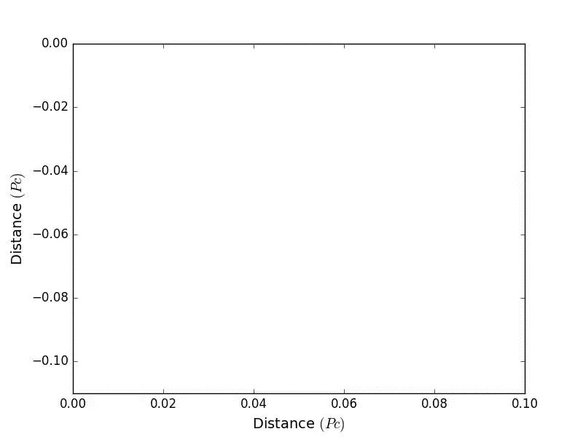
Dynamical interactions of the protostars

Slide 16
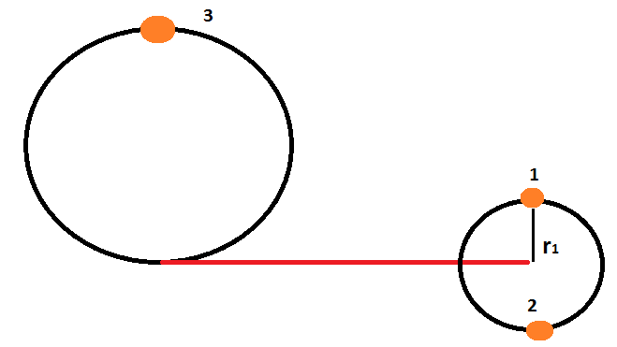
What’s Left ?
Finding Binary systems and their parameters
Finding the stars that are most closely bound to each other.
i.e E_{grav} > E_{kin}
Finding various parameters such as the eccentricity and the semi-major axes.

Slide 17
Varying the Initial conditions
Creating colder and hotter groups and examine any variance in the parameters compared to groups which are at Virial equilibrium.
if E_{grav} > 2E_{Kin} the system is Cold
if E_{grav} < 2E_{Kin} the system is Hot
Finding any variances in the probability of an ejecta between each scenario.

Slide 18
References
André, P. et al., 2010. From filamentary clouds to prestellar cores to the stellar IMF: Initial highlights from the Herschel Gould Belt Survey. Astronomy and Astrophysics, Volume 518, p. L102.
Dahir, A., 2013. N-body Simulation for Kepler 11 System. [Online] Available at: http://ccar.colorado.edu/asen5050/projects/projects_2013/Dahir_Andrew/Pages/N-body%20Problem.htm
Ward-Thompson, D. & Whitworth, A., 2011. An Introduction to Star Formation. : Cambridge University Press.

Slide 19
Thank you for listening

Slide 20
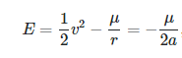
Semi-major axis
Can find the semi-major axis through the following equation :-
Where μ = G(M + m)

Slide 21
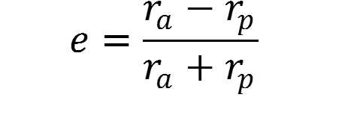
Eccentricity of an orbit
Can find the eccentricity through the following equation :-

